Slide 1


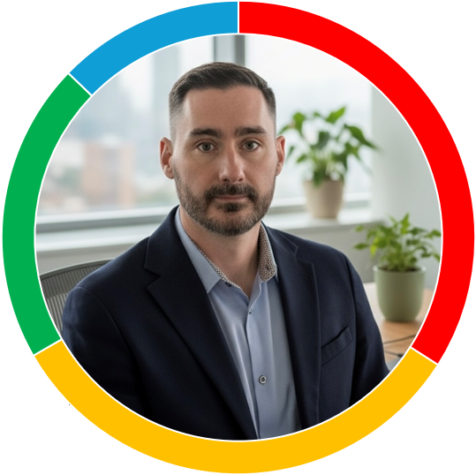





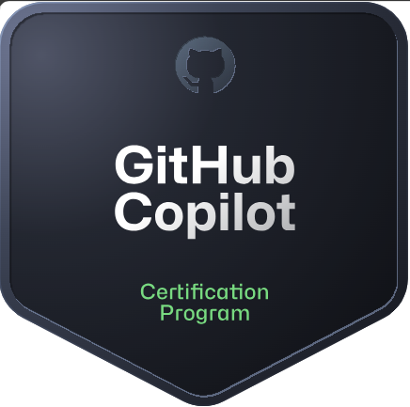
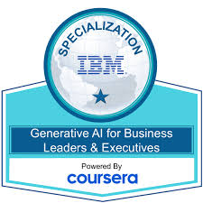
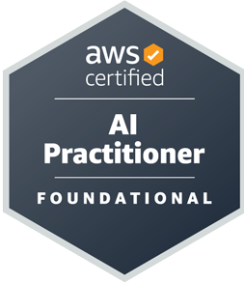

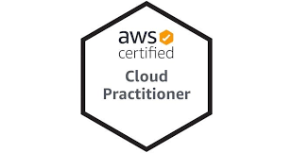




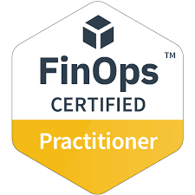





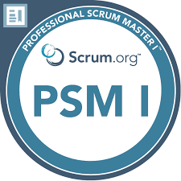

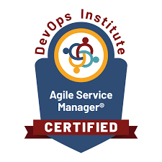
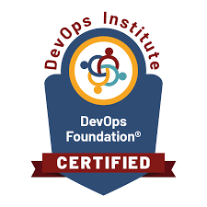
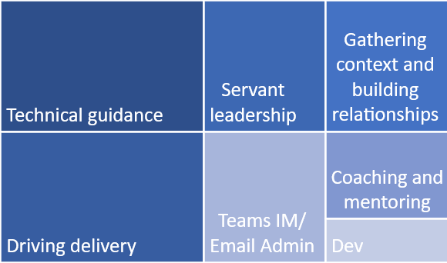





Joe Lewis - Technology Executive
2 years as Director of Software Engineering.
Learned:
Large scale leadership (> 700 FTE). Improving poor culture under delivery pressure.
Product led and customer focus.
Grantham based, seeking London-hybrid
MSc GIS Systems and Environmental Informatics
+44 7843 081 640
joelewisnotts@hotmail.co.uk
https://uk.linkedin.com/in/joe-Lewis-notts
Executive Leadership Programme
3 years as Director of Cloud, SRE and DevOps.
Learned: SRE, Finance P&L ownership
Private Equity sale/ purchase/ Due Diligence
Professional Summary
Growth mindset technology executive with 25 years of leadership experience, mainly in financial services. Renowned for driving transformation across the entire technology lifecycle. Expert in building and modernising large-scale, cloud-native platforms and optimising legacy estates for public cloud migration.
Influential with C-level stakeholders, I lead global engineering organisations of over 700 professionals, instilling a high-performance culture of Engineering. Distinguished for strategic vision, operational excellence, and managing substantial budgets in highly regulated environments.
Exam in October…
Implementing AI into the Engineering culture to create >50% of code through AI tooling.
Using AI to optimise daily tasks
10 years finishing with 3.5 as Head of App Support
Learned: Most of what I know! Very strong process controls, Cyber, Cloud Migration, Cloud architecture excellence, Agile and agility, DevOps and modern software development, leadership and management, self-awareness, and more…
Professional Profile
Fluent in major cloud platforms and modern, cloud native application architectures
Coaching and improving behaviours and more effective culture
Seeing delivery efficiency directly from my leadership and guidance
2 years in Software Configuration
Learned: Large strategic programmes and dev cycles
Being autonomous and driving my own destiny
Year of P&L ownership and Cloud accounting mechanisms, business recharge and optimisation
Occasionally getting into technical detail to make roadmap decisions
Reviewing detail, so I use AI tools to get the information I need
Driving low level tasks, so I build empowerment/ autonomy in my leaders
4 years technical support and ITSM.
Learned: Finance, enterprise software technical skills, Process/ ITSM.
Deeply experience in optimising delivery efficiencies through Agile methodologies
Balance of my time
Hobbies
Location
4 years software coding
Learned: software development coding and line management.
Guitar
Football
Cycling
Running
At Home
London or other UK Offices
Offices abroad
Evangelist in DevOps practices to improve flow, delivery efficiency and predictability
2 years application support.
Learned: Technical skills and Corporate life without bikes.
Years of operational experience focussed on high availability and tight regulatory expectations

Slide 2




Strategic Leadership
People Leadership
Regulation and Risk
Technical direction
Gather organisational context for decision making
Create Technology vision and strategy
Prioritise and sequence on value
Share clarity regularly on direction
Track progress through leading indicators, not trailing
Communicate progress
Celebrate success
Plan technical roadmaps to work towards
Keep critical knowledge in house
Outsource for resource augmentation or contained outcomes, not problems
Promote Growth mindset
Treat everyone with respect
Increase empathy in leaders
Coach & develop collaborative behaviours
Raise expectations and push improvement
Assign single-threaded owners
Develop intrinsic motivation
Build autonomy and empowerment
Push decisions to those with information
Promote ‘now that’ rewards
Hold tough conversations early
Talk in facts, not emotions
Mentor emerging leaders
Securing customer data = job #0
Service stability = job #1
Build security testing into the SDLC and test regularly
Standard processes increase consistency and adherence
Run detective controls to test adherence to policies
Anticipate audits, implement preventative measures
Understand regulatory commitments
Achieving budget is everyone’s objective, push ownership down
Costs should be owned by those with the most influence on the roadmap
Understand product profitability of Tech costs
AI Writes half of your code
Automate all manual work (SRE)
Security, Testing and Infrastructure as code
Build cloud native first
Build/ deploy through CI/CD
Utilise open source, avoid vendor lock in
Break monolithic systems down through decoupling APIs
Centralise identity to simplify control
Micro front ends and single page apps
Shift operations work left to reduce costs
Build security testing in SDLC
Fail-over regularly to validate resiliency
Focus on value, through a Product led mindset, obsess about the customer

